Slide 1
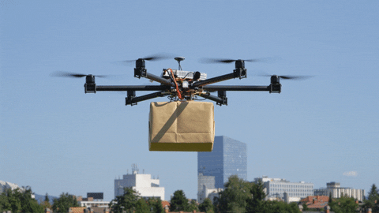
FINANCE DEPARTMENT
NMO S4 SPRINT ONE | BUSINESS CASE SCENARIO - 04 | AIRWAY DELIVERY:
TEAM EARTH
AIRWAYS
“We Give You Wings to Your Package”
Hyper Local Delivery Space Through Drones
Head of Finance Department
( Gaurav Sasturkar )

Slide 2
The key areas where most of the budget amount has been spent :
Digital Marketing
Promotional Material
Company Website
App Development
Drone Operations
Other Miscellaneous Expenses

Slide 3
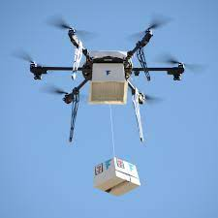
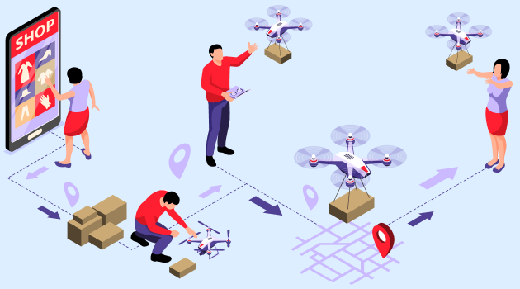
Planning for FY 21-22 with Expenditure Budget :
Sr No. | Particular | Quantity | Cost / per unit (INR) | Annual Expenditure
1 | Short Range Drones | 4 | 1,25,000 | 5,00,000
2 | Long Range Drone | 1 | 4,00,000 | 4,00,000
3 | Qualified Drone Operators | 4 | 50,000 | 24,00,000
4 | Management Team | 5 | 1,00,000 | 60,00,000
5 | Software | 1 | 25,00,000 | 25,00,000
6 | Software Development Team | 2 | 70,000 | 16,80,000
7 | Support Staff | 4 | 20,000 | 9,60,000
8 | Office Rent | 1 | 30,000 | 3,60,000
9 | Marketing | 2 | 3,50,000 | 14,00,000
10 | Miscellaneous Cost | 1 | 20,000 | 2,40,000
 | TOTAL OPERATIONAL COST FOR FY 21-22 |  |  | 1,64,40,000

Slide 4
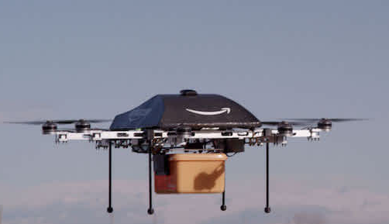
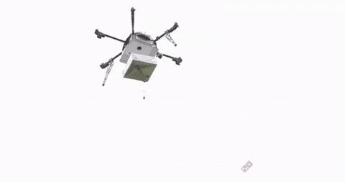
Courier Service Charges:
Category of Couriers | Courier weight | Price
A | 0.1 grams to 500 grams | 60 Rs.
B | 501 grams to 1 Kg | 80 Rs.
C | from 1.01 Kg to 5 Kg | 100 Rs. /Kg
D | 5.01 Kg to 10 Kg | 110 Rs./Kg

Slide 5
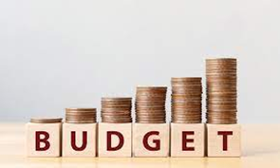
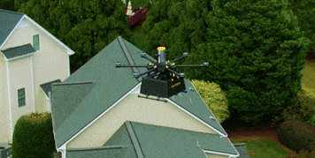

Slide 6
